Slide 1

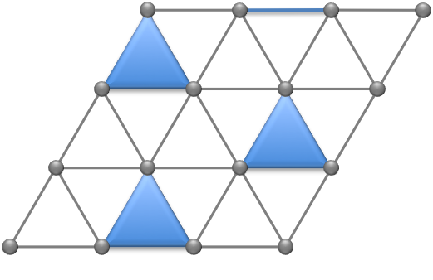
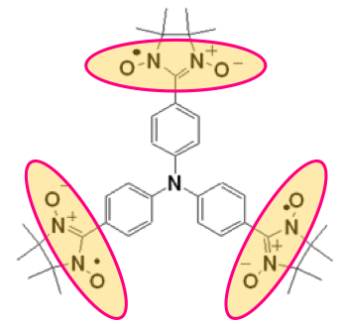
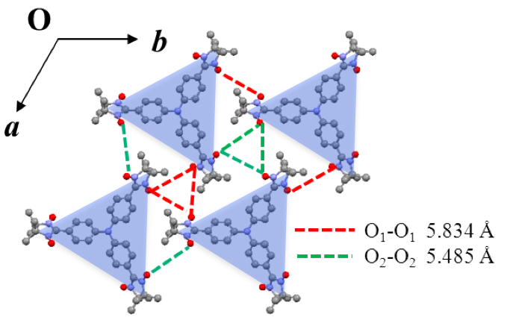
Multiferroics by design with frustrated magnets with trimers
KITS, Beijing (June 6, 2017)
Yoshi Kamiya
Condensed Matter Theory Lab., RIKEN

Slide 2

Emergent phenomena in strongly correlated/frustrated systems
Degenerate manifold of low-energy states (e.g., due to frustration)
  Order by (thermal/quantum) disorder : exotic spin states
Possibility of having quantum spin liquids
    Kitaev model and related candidate materials w/ strong SOC
    Emergent gauge fluctuations and Majorana fermions (spinons)
Effect of interactions on topological state of matter
    Surface Majorana zero modes bound to an Abrikosov vortex lattice
Conventional perspectives
MF theory
Spin-waves
Emergent theories
Topological order/QSLs
Fractional excitations

Slide 3
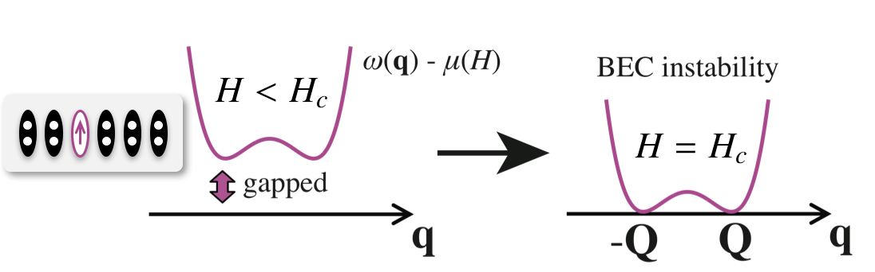
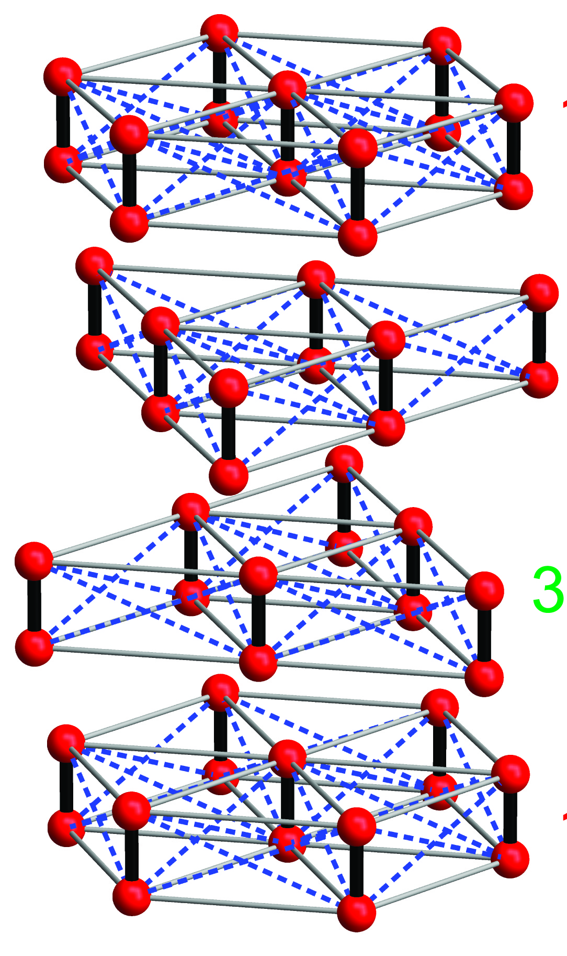
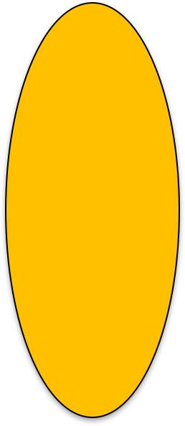
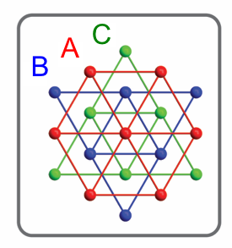
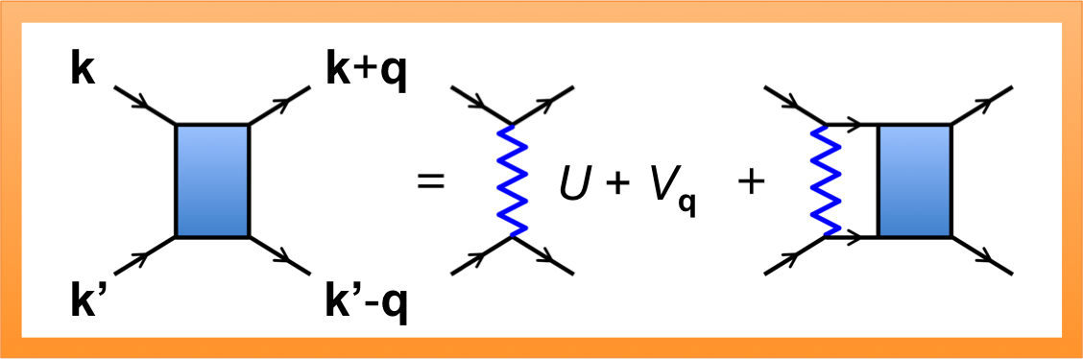
Vortex crystals in frustrated quantum magnets
YK and Cristian Batista, PRX 4, 011023 (2014)
Ba₃Mn₂O₈
Samulon et al., PRB 77, 214441 (2008)
“triplon”
Stone et al., PRL 100, 237201 (2008)
A
T
H = H_{c}
B
quantum
paramagnet
XY ordered
H
C
Triplon dispersion w/ six minima ±Q₁, ±Q₂, ±Q₃
A
Mn⁵⁺ (3d²; S=1)

Slide 4
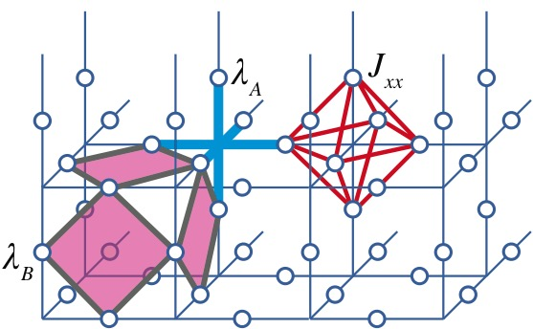
Flux-loop (de)confinement in the 3D Kitaev/toric code model
YK, Y. Kato, J. Nasu and Y. Motome,
PRB 92, 100403(R) (2015)
Hyperhoneycomb Kitaev model
Extended 3D toric code (QMC)
J. Nasu et al., PRL 113, 197205 (2014)
Universal 2nd order phase transition to the Z₂ QSL in 3D
Gapped flux-loop excitations : (de)confined at low (high) T
Emergence of critical loop-length distribution at T = T_{c}

Slide 5
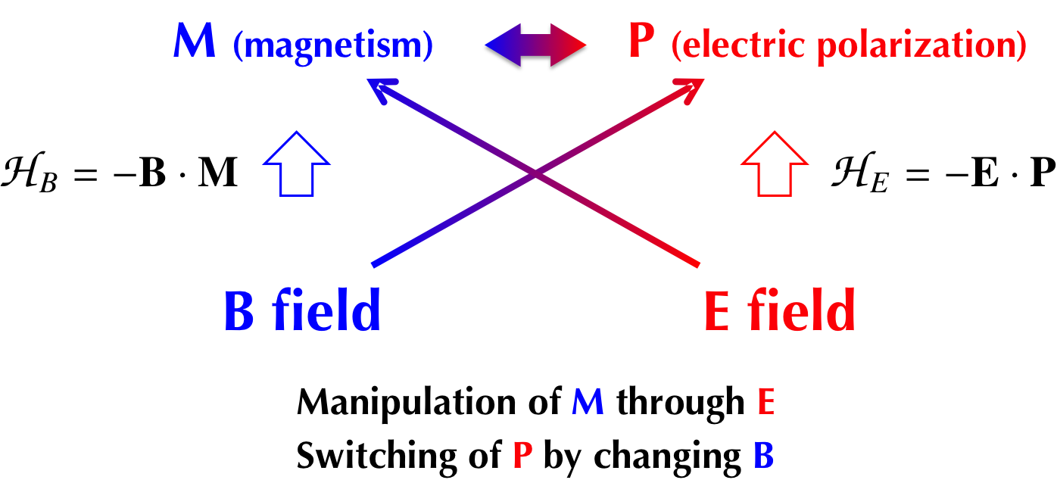
This talk’s focus : Multiferroics
Coexistence of different orders and large cross correlations
Tokura et al., Rep. Prog. Phys 77, 076501(2014)
Cheong and Mostovoy, Nature Mater. 6, 13 (2007)
Mechanisms
spin-current mechanism [Katsura et al., PRL 95, 057205 (2005)]
magnetostriction
d-p hybridizations [Arima et al., JPSJ 76, 073702 (2007)]

Slide 6
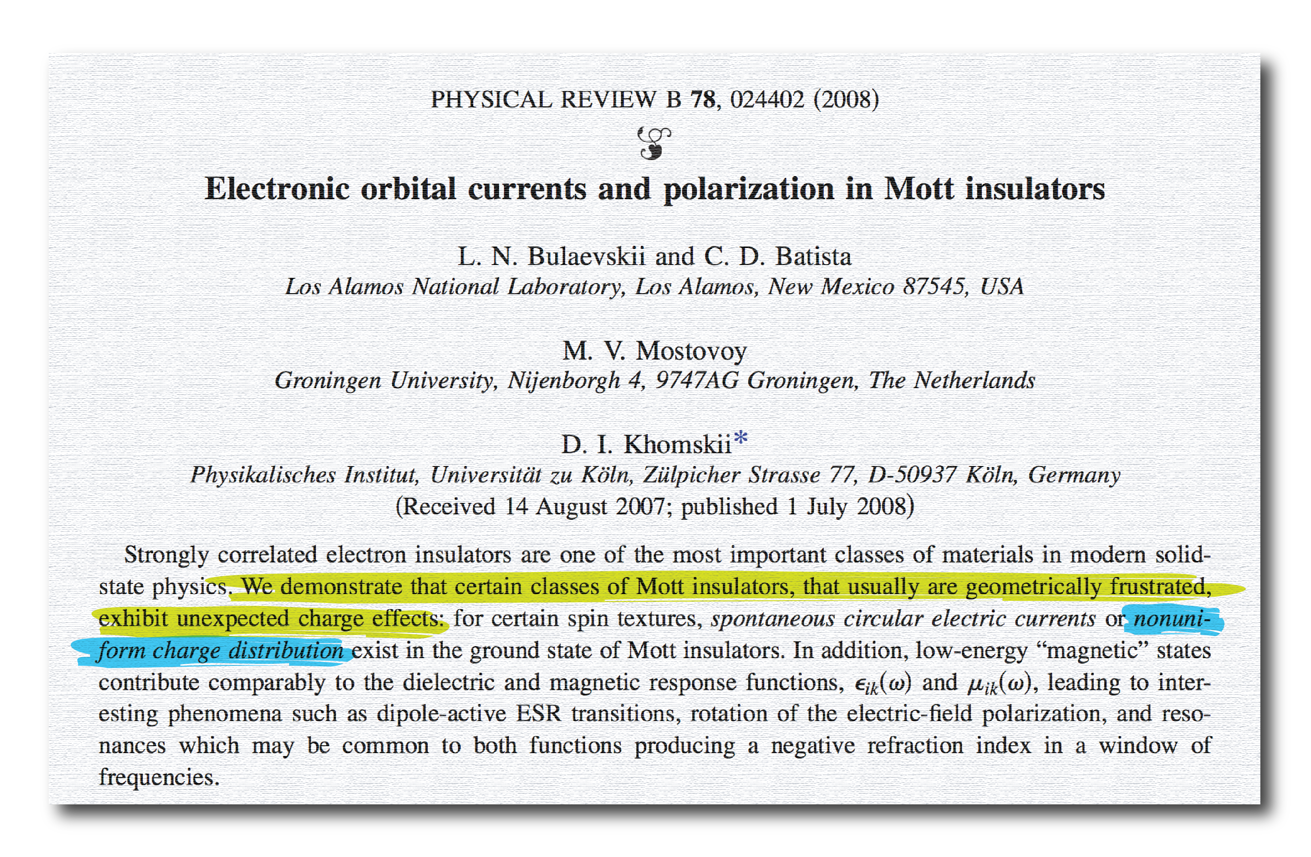
Motivation : correlation physics
Possible charge fluctuation in frustrated Mott insulators
(due to perturbative processes)
Can we use this correlation physics to design a new multiferroic material ?

Slide 7
Outline of my talk
Model comprising “trimers”
Effective operator for charge fluctuations in Mott insulators
Weakly-coupled trimers and low-energy effective theories
Experiments on the crystalized molecular magnet TNN
Comparison with theory and discussions/outlook
S = 1/2
S = 1/2

Slide 8
Multiferroics with trimers
Kamiya and Batista, PRL 108, 097202 (2012)
Half-filled Hubbard model on a trimerized triangular lattice with small t_{ij} / U :
trimer
t
U
t’
U
Low-energy effective model :
a trimerized Heisenberg model
second-order process

Slide 9
Effective charge operator
Bulaevskii et al., PRB 78, 024402 (2008)
Deviation from the average density (= 1)
Isn’t this trivially zero in Mott insulators… ?
for any spin states like
(however, this is NOT what we need to look at)
We need to evaluate it with a perturbed basis
e^{-S} is a canonical transformation (perturbation series in t_{ij} / U)
P_{spin} is a projection operator to the spin states
Effective operator

Slide 10
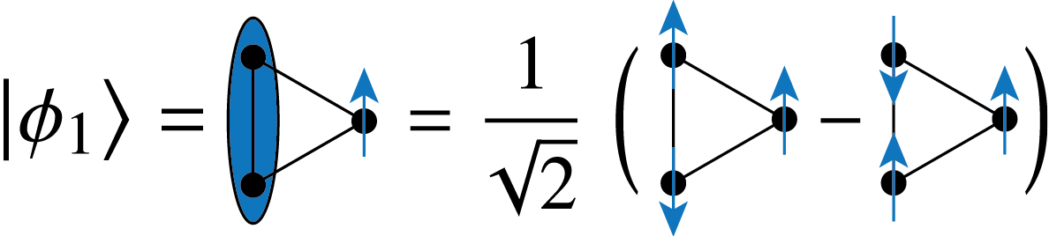
Simplest example
Virtual process in a single trimer
Subspace with (1) S = ½, (2) S^{z} = ½, (3) even parity under exchanging i₂ & i₃
i₃
hopping term
i₂
i₁
Perturbation series for the wave function
Virtual processes are polarized states
P

Slide 11
Leading 3rd-order contribution
We only count the contribution from intra-trimer loops
Deviation from the average density (= 1)
t
t’
x
i
small t / U
y
perturbation theory
k
j
Bulaevskii et al., PRB 78, 024402 (2008)
a
e^{-S} is a canonical transformation
=
Consistent with symmetry considerations : spin-scalar, even under time-reversal

Slide 12
Leading 3rd-order contribution (cont’d)
Polarization density per trimer
t
t’
x
i
y
k
j
a
The intra-trimer bond order implies a local in-plane dipole moment

Slide 13
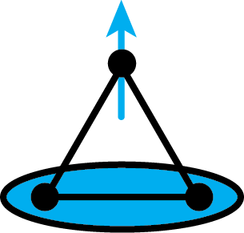
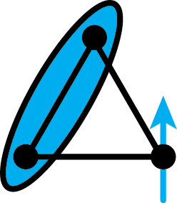
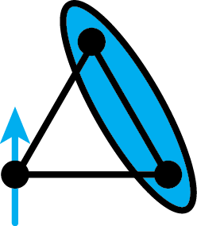
Spectrum of a single trimer
i₁
x
y
i
i₃
i₂
The low-energy S = 1/2 states retain
both spin and “orbital” degrees of freedom
trimer’s total spin
“orbital” pseudospin
e.g.,

Slide 14

Weakly coupled trimers
Kamiya and Batista, PRL 108, 097202 (2012)
P
Vertically stacked trimerized triangular lattice

Slide 15
Spin-orbital effective model
Kamiya and Batista, PRL 108, 097202 (2012)
Weakly-coupled trimers are spin-
orbital systems described by a Kugel-Khomskii Hamiltonian.
Projection of inter-trimer exchange
i₁
i₁
i
i
( is the projector to the S=1/2 subspace)
i₂
i₃
i₃
i₂
j₁
j₁
j
j
j₃
j₂
j₃
j₂
Effective Hamiltonian for J >> J₁’, J₂”

Slide 16
MF theory for the simple lattice
trimer spin
Kamiya and Batista, PRL 108, 097202 (2012)
orbital
ferrimagnetic-antiferro-
electric 2 (FIM-AFE2) state
ferromagnetic-ferro-electric (FM-FE) state
magnetic field
interlayer coupling
FM
AFM
ferrimagnetic-ferri-electric (FIM-FIE) state
(normalized by the intralayer coupling)
canted antiferromagnetic-
ferrielectric (CAFM-IE) state

Slide 17
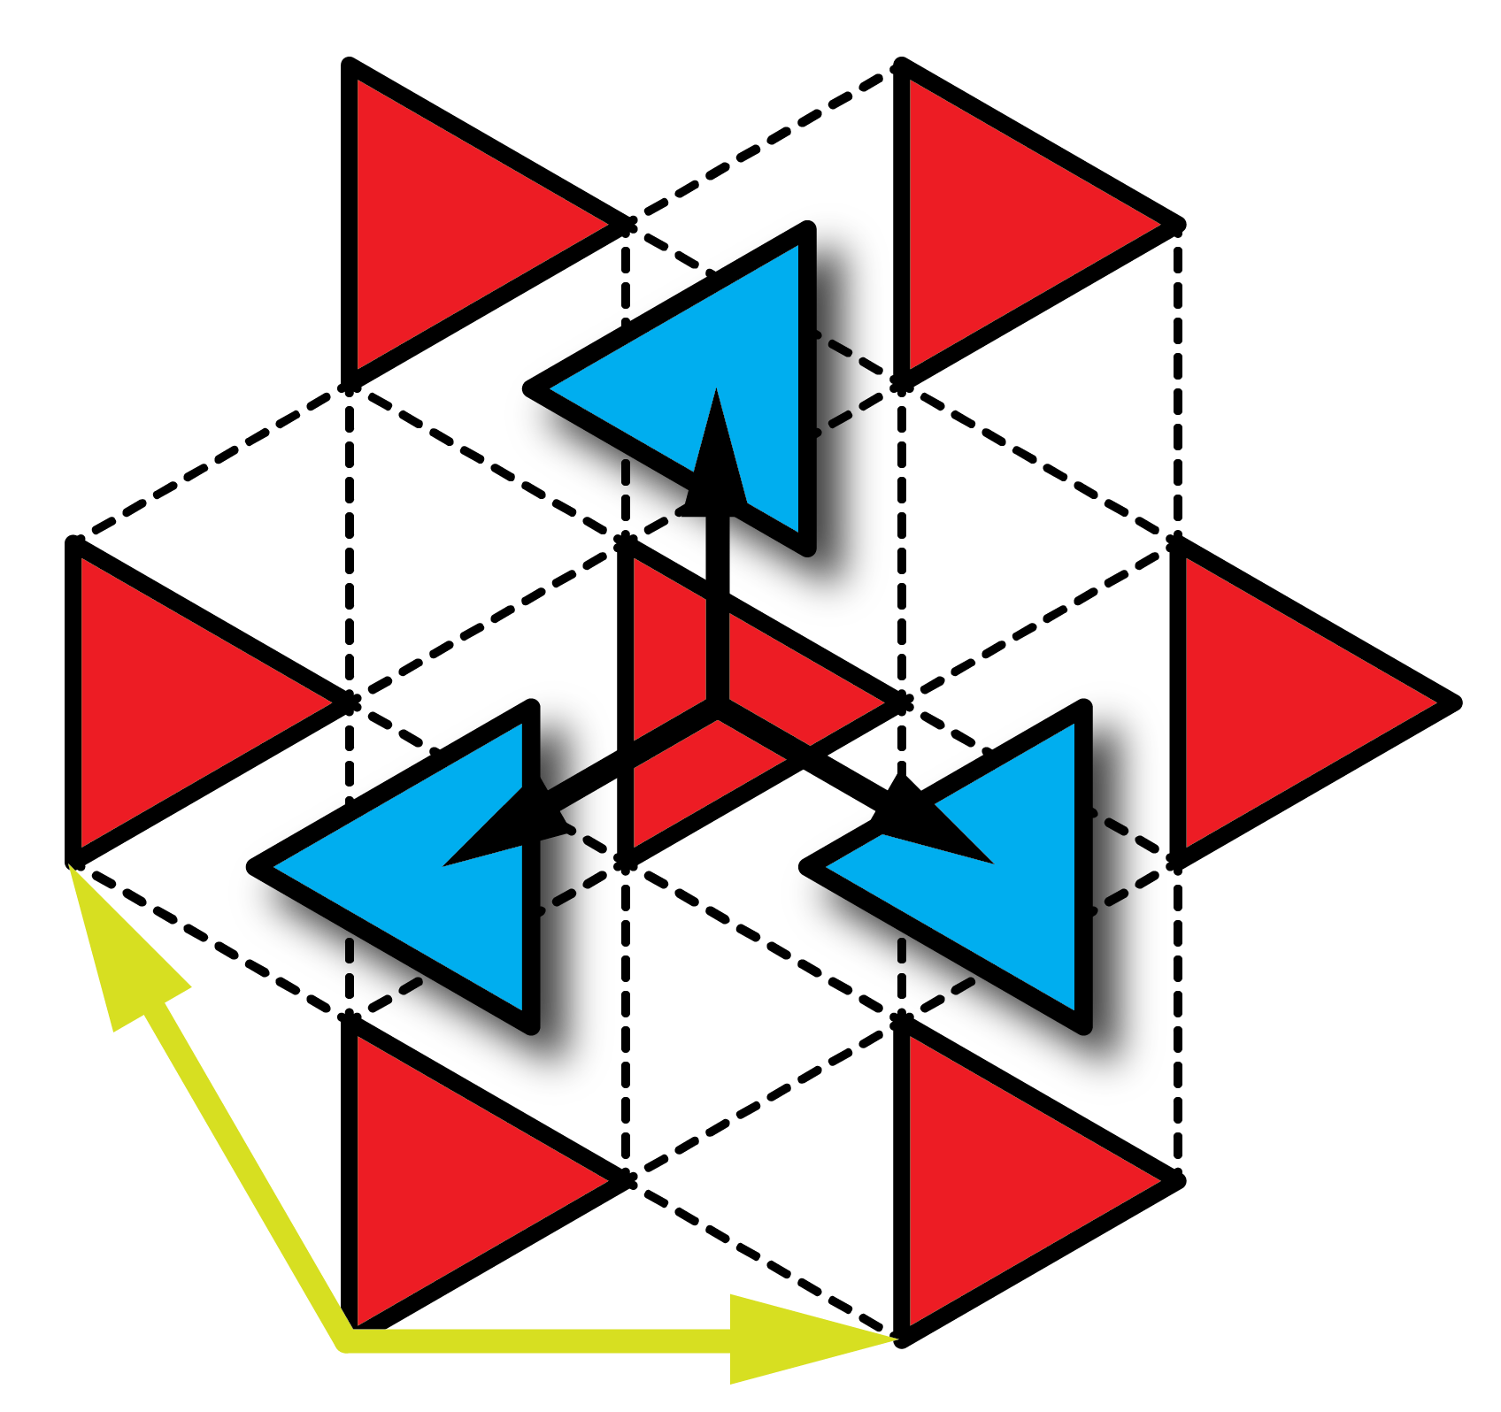
Organic molecular magnets with trimers
Kamiya et al., in preparation
Nitronyl Nitroxide (NN)
radical (carrying S=1/2)
Y. Nakano et al.
(2005)
molecular magnet TNN
Two different molecule structures
Single crystal TNN∙CH₃CN
(or simply TNN)
“A-B-C-A-B-C”-type stacking

Slide 18
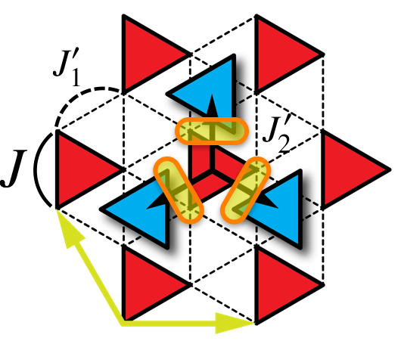
Semiclassical theory for TNN
Start from weakly coupled trimer (quantum) model and derive effective models for each field regime
The low-field regime (first “dome”), the intermediate-field regime (plateau) & the high-field regime (second dome)
After deriving the effective models, regard the spin/pseudospin operators classical; determine the phase diagram w/ MC

Slide 19
Comparison of the phase diagrams
TNN crystal
Theory
Kamiya et al, in preparation
T (K)
Sorry!
We want to keep this unpublished experimental data confidential.
Model
  Ferroelectric 1/3 plateau
  Fully Polarized
The results are qualitatively consistent with experiments
AFE
FE
(quantitative accounts of T_{c}’s cannot be hoped anyway)
ferroelectric (FE)
antiferroelectric (AFE)

Slide 20
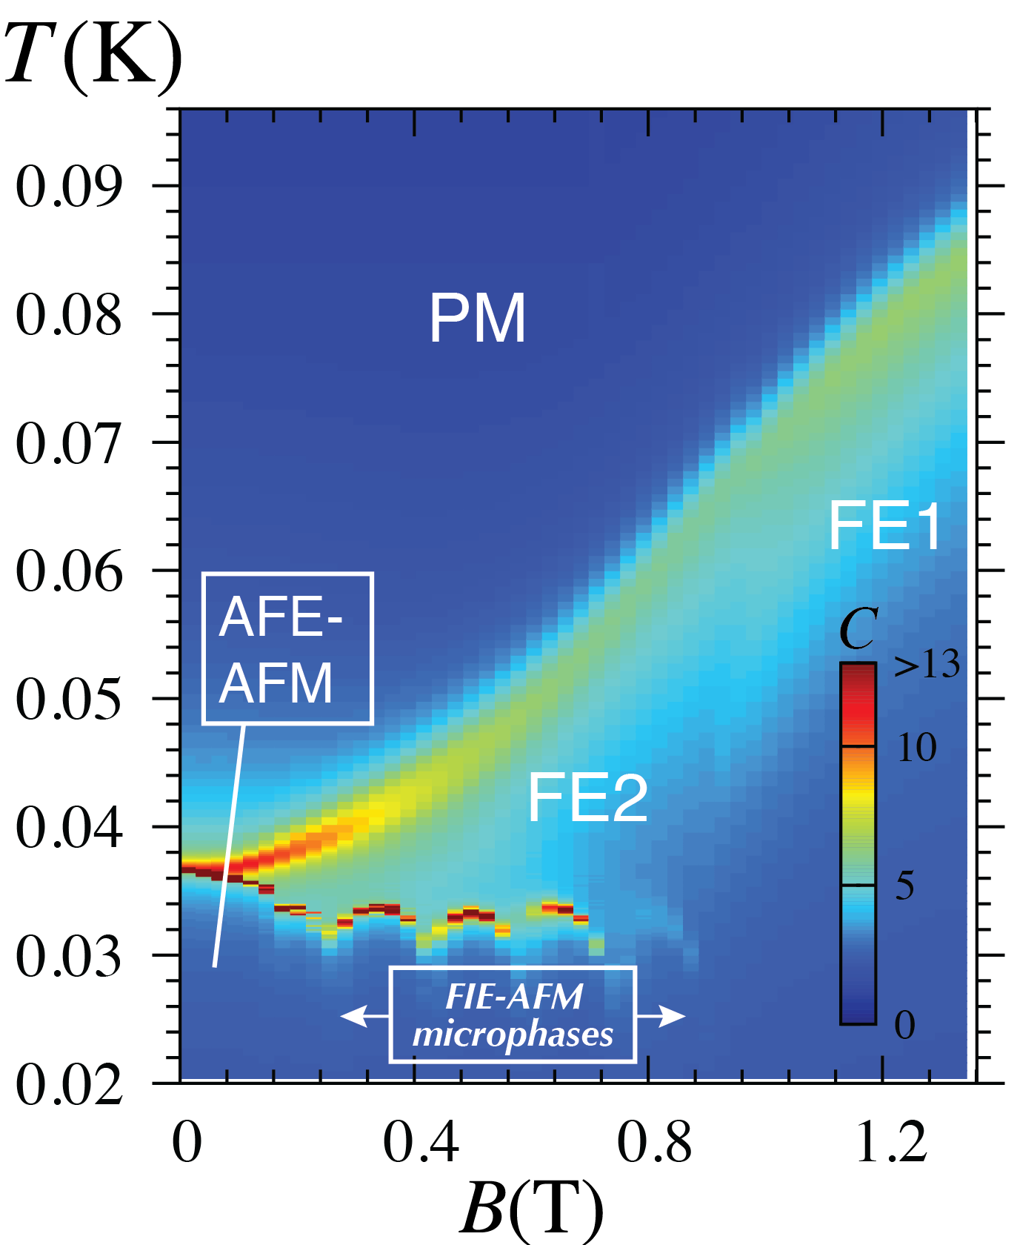
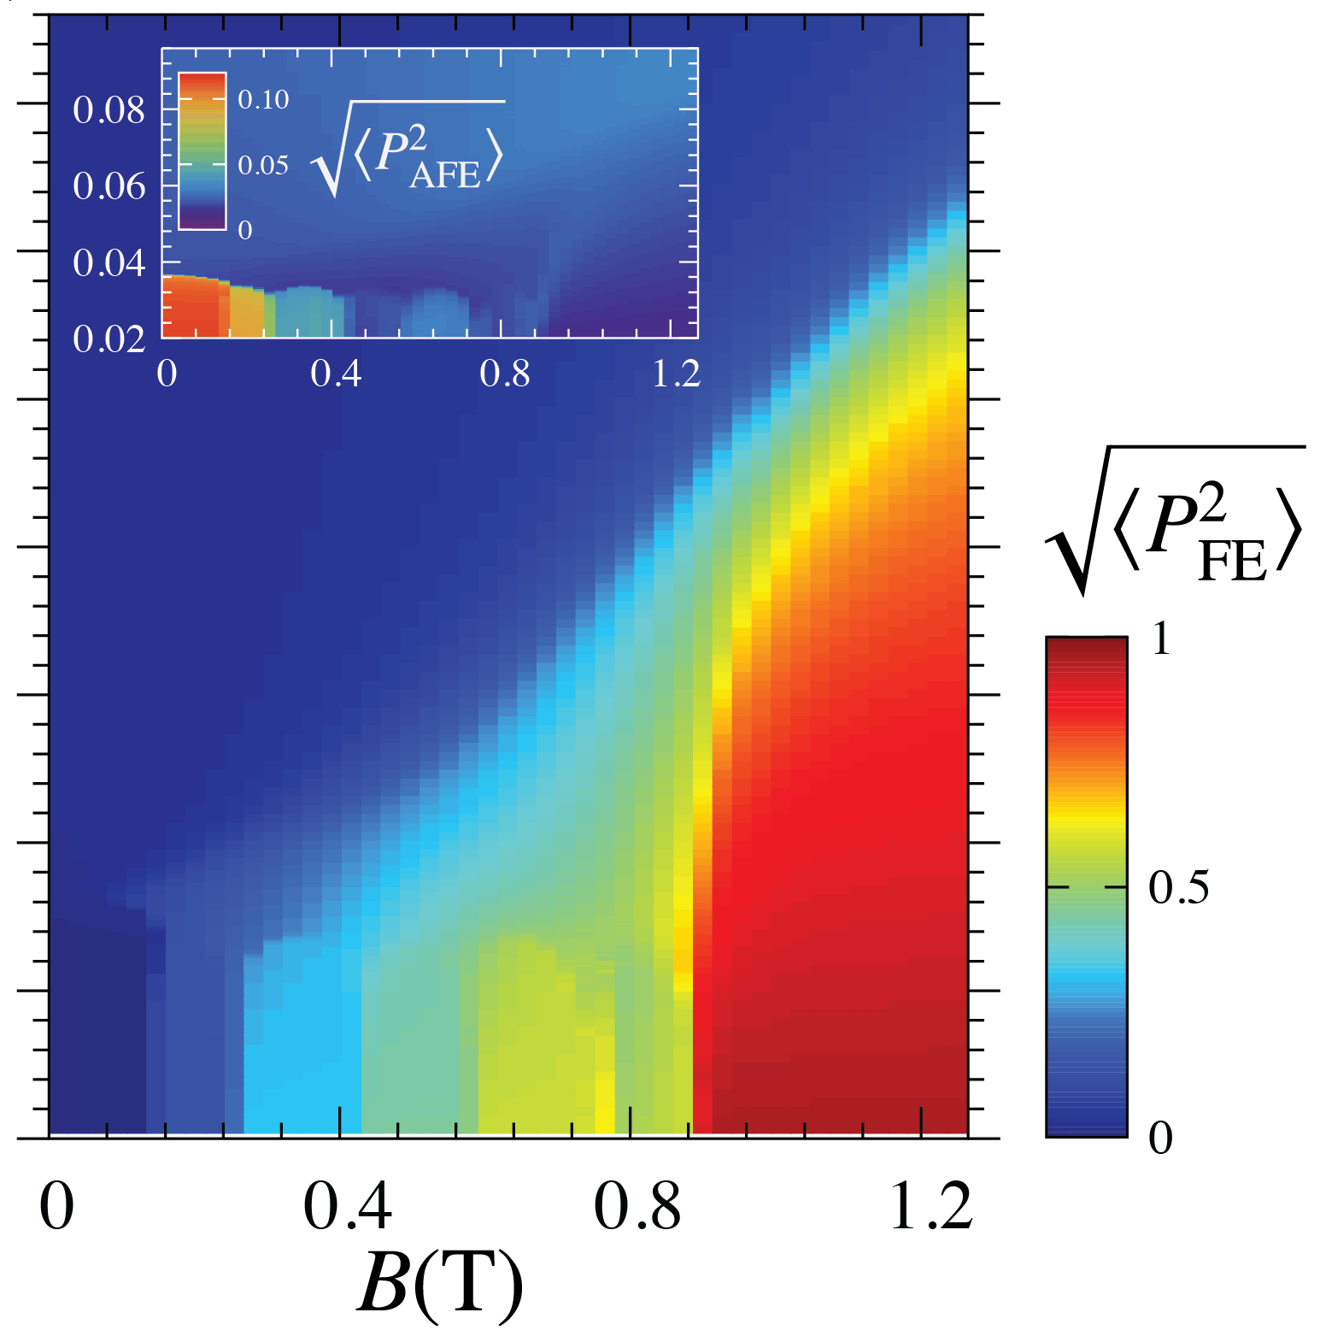
Low-field regime
The 1/3 plateau is a ferroelectric state (“FE1”)
Antiferroelectric phase (“AFE”) near H = 0
Ferroelectric phase (“FE2”) at intermediate T and H
Additional phases at low T
specific heat
electric polarizaton
1/3 plateau

Slide 21
Rather complicated low-T states
Microplateaux in M(H) -- very sensitive to the system size.
“Spins” are pointing along the z axis
Spiral-like order for “pseudospins” (orbitals or FE moments)
1/3 (1)
orbital DOF
(XY components)
spin DOF
XY : arrow
Z : color
2/9
(2/3)
1/6
(1/2)
1/9
(1/3)
1/18
(1/6)

Slide 22
FE order in the 1/3 plateau
The large magnetic field polarizes the S=1/2 sector, leaving only the orbital degrees of freedom.
M
Effective Hamiltonian in the plateau regime (intra-layer part)
H
Hamiltonian for orbitals
ferro-orbital intra-layer coupling
The spin frustration is released by the orbital ordering

Slide 23
Above the 1/3 plateau
New player : from each trimer
Behaving as bosonic “holes” for pseudospins
Phase competition thru the “double-exchange” mechanism

Slide 24
Summary
TNN.CH₃CN is a new multiferroic organic material where electric polarization arises from trimerized units driven by virtual electronic fluctuations.
Locally, electric polarization emerges due to 3rd order perturbative processes in t / U within each trimer.
Weakly-coupled trimers are “spin-orbital” systems where the spins affect the orbitals and vice versa. Therefore, the lattice structure of trimers is of crucial importance for realizing multiferroicity and TNN has an ideal one.
Y. Kamiya and Cristian Batista, Phys. Rev. Lett. 108, 097202 (2012)
Y. Kamiya et al., in preparation

Slide 25
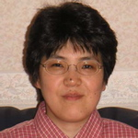








Collaborators
Crystal synthesis and bulk measurements
  K. Takada, H. Yamaguchi, T. Ono,
  and Y. Hosokoshi (Osaka Prefecture Univ)
Additional bulk measurements
    C. P. Aoyama and Y. Takano (Univ of Florida)
    Y. Shimura and T. Sakakibara (ISSP)
    Minseong Lee and Eun Sang Choi (NHMFL)
Theory
  C. D. Batista (Univ of Tennessee and ORNL)
  H. Nakano (Univ of Hyogo)

