Slide 1
Fractional Berry phase effect and composite particle hole liquid in partial filled LL
Yizhi You
KITS, 2017

Slide 2
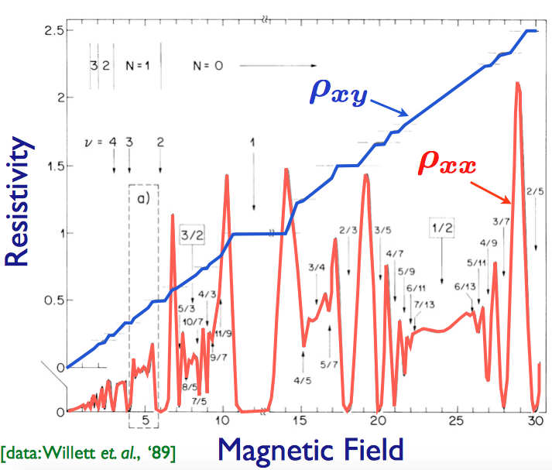
Partial filled Landau Level?
✔Odd filling fraction?
Topological order,
mostly Abelian (non-Abelian)
✔Even filling fraction?
Fermi surface with non-Fermi liquid behavior
non-Abelian (Pfaffian state)
Half-filled LL?

Slide 3
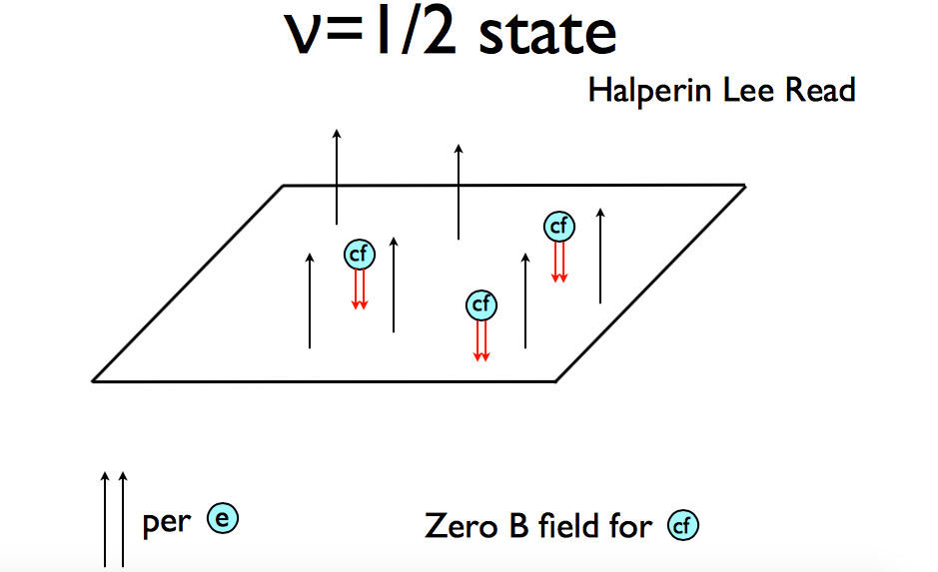
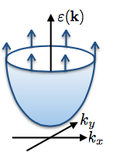
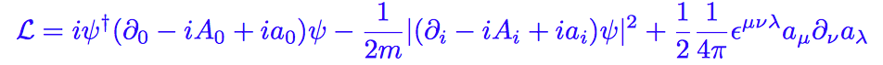
Composite Fermi surface couples to a dynamical gauge theory with CS term
= Non fermi-liquid!

Slide 4
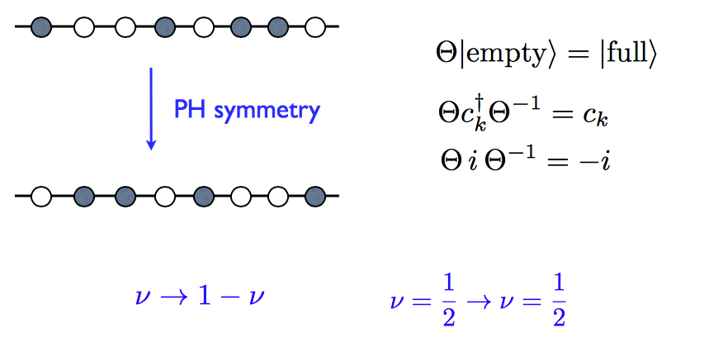
Problem:
PH symmetry missing?
In the 0th LL limit, PH symmetry should be exact at half filling！
Hall conductivity 1/2 by symmetry?
Pfaffian, anti-Pfaffian?

Slide 5
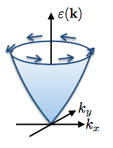
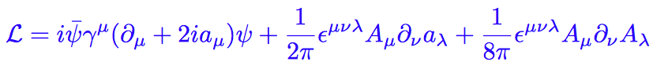
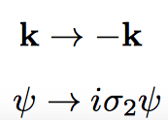
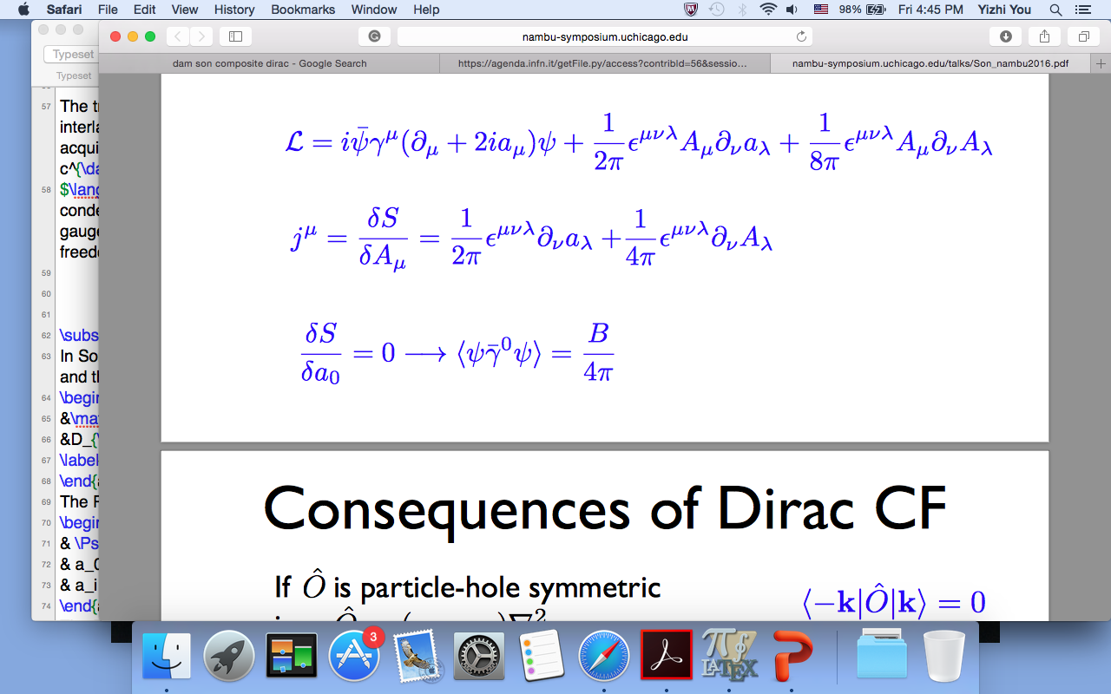
Son’s theory: Dirac Fermi surface
✔ Composite Fermion forms Dirac Fermi surface
✔ PH symmetry akin to Time reversal
CF density=magnetic flux
Electron density fluctuation = gauge flux

Slide 6
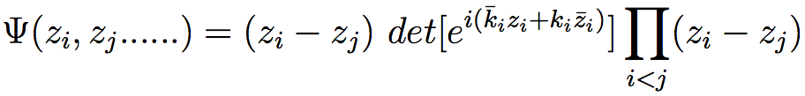


Why Dirac?
Dirac is not important! (Haldane 2015)
The essence comes from the Berry phase of CF
Only fermions near the Dirac Fermi surface = Half-filled LL! (Wang-Senthil)
LL projection
-e
e/2
e/2

Slide 7
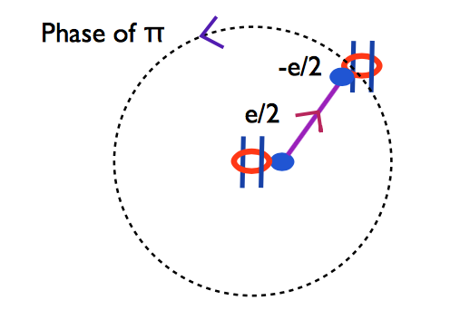
Why Dirac?
Dirac is not important! (Haldane 2015)
The essence comes from the Berry phase of CF
Only fermions near the Dirac Fermi surface = Half-filled LL! (Wang-Senthil)
LL projection
k
-e
Read; Wang-senthil
e/2
e/2

Slide 8
Dirac is not important! (Haldane 2015)
The essence comes from the Berry phase of CF
Only fermions near the Dirac Fermi surface = Half-filled LL!
LL projection
k
Charge dipole
Spin-momentum locked
neutral
-e/2
e/2

Slide 9
Comment on composite Dirac theory
`Dirac-ness’ is not essential!
(Dirac point is not presented)!
All we want is a `π Berry phase’ on the Fermi surface
✔ Berry phase is a consequence of LL projection (not PHS, while PHS protects the Berry phase)
✔ In HLR, Chern-Simons term = vortex (correlation hole) statistics
In Son, The π Berry phase comes from vortex statistics + momentum dipole locking!

Slide 10
Q: How to identify Son theory with HLR theory?
Q: How to identify the hidden π Berry phase of the composite Fermi surface?
Interacting problem, NFL?
Fermi surface is neutral
All about measurement!

Slide 11
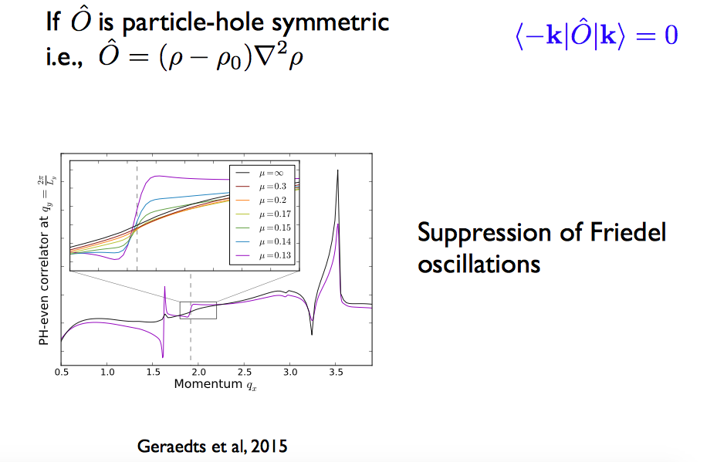
ν=1/2
-K
K
Back-scattering at 2k_f, PH odd

Slide 12
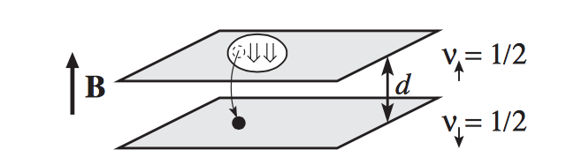

Berry phase <-> spin momentum locking
How to measure the spin-momentum locking?
Spin is not physical spin(valley spin)
Spin order -> angular momentum channel
Spin response to geometry (topological spin) -> Wen Zee effect
Bilayer ½ filled LL
Coherent CFL!

Slide 13
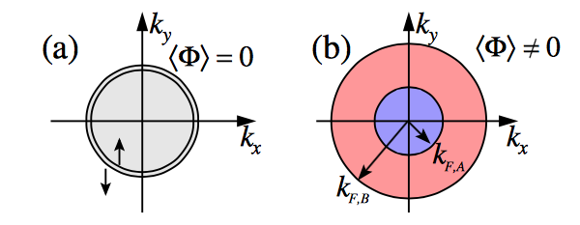
(Alicea 2009)
Interlayer coherent CFL: Exciton of the composite fermion
Bilayer ½ Filled LL from HLR theory
Splitting between 2
Fermi surface
Static Density-density correlations:
Decoupled layer: 2k_f singularity
coherent layer: 2k_f,(2k_f+2a), (2k_f-2a) , 2a singularity

Slide 14
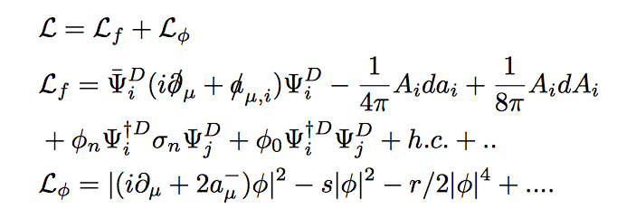
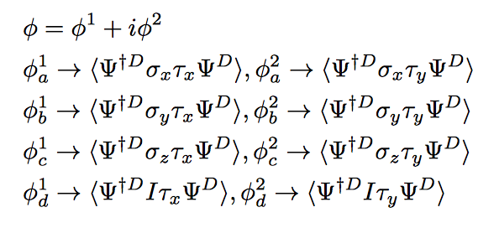
Bilayer ½ filled Landau Level from Son theory
Interlayer coherence between Composite Dirac Liquid
Exciton of the composite fermion
PH odd channel

Slide 15

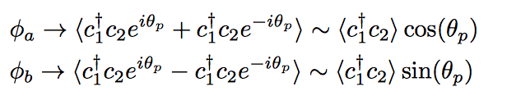
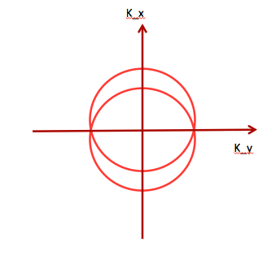
Project the fermion near the Fermi surface
PH odd channel
Phase dependent in k space!
Nodal structure!
Due to Berry phase of Dirac Fermi surface
Measurement : Static Density-density correlations , Singularities depends on momentum angle

Slide 16
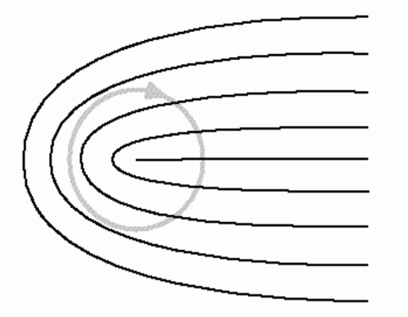

Nematic ICCFL state
Consequence of the Berry phase:
What to expect in such phase?
Half quantum vortex, bound with π disclination
Minimal gauge flux for a⁻ -> π/2
Trap layer charge density imbalance N=1/4

Slide 17


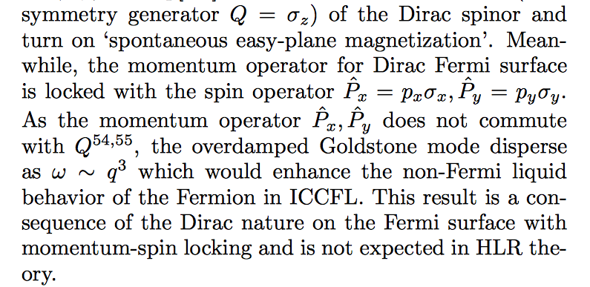
Goldstone boson
Interlayer U(1) symmetry, Higgsed, Gapped
Rotation symmetry breaking, gapless, over-damped mode:
Not expected in HLR!
Origin from the Berry phase nature, spin-momentum locking!

Slide 18
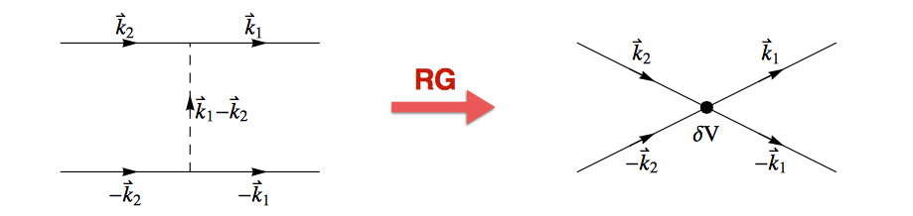
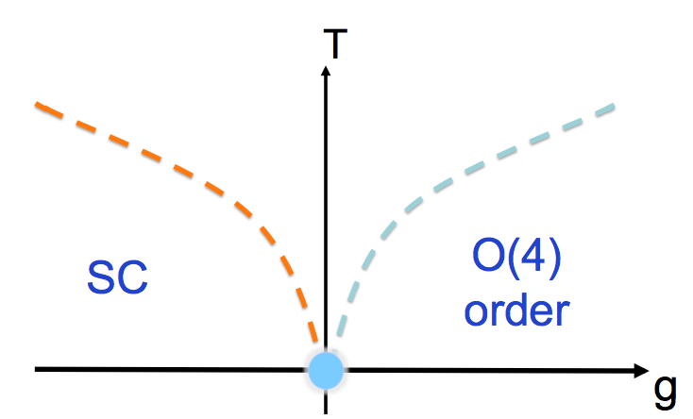
What happen at the QCP?
Exciton fluctuation enhance intra-layer SC
This is not expected in HLR.
As a consequence of the Berry phase structure.
Same as the nematic enhancement for SC!
Intralayer-SC
dome ?
ICCFL
Decoupled bilayer

Slide 19
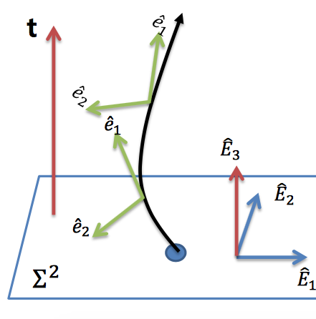
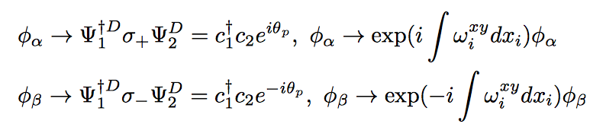
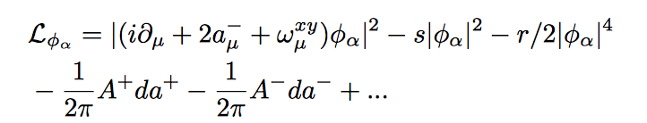
Label exciton channel by topological spin number

Slide 20
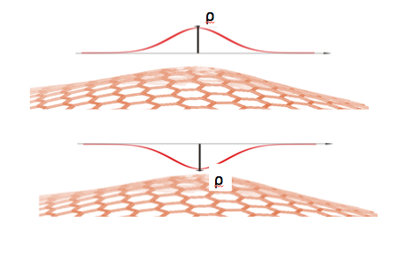
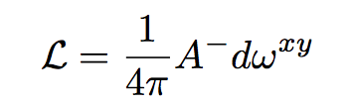
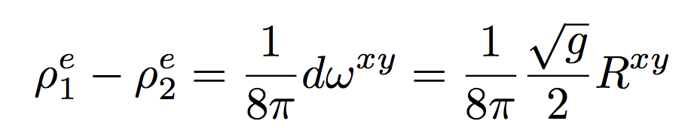
Wen-Zee effect!
(electron’s) Density modulation due to geometry curvature
Could be observed in experiment (Simon et al. 2016)

Slide 21
Partial filled Landau Level at arbitrary even filling fraction?
Composite (non) Fermi liquid?
Fractional Berry phase due to LL projection?
…..
-e
1/2n filling fraction
2n vortices

Slide 22
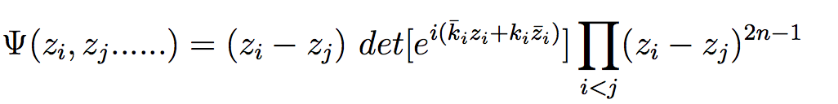
LL projection
-e
…..
1/2n filling fraction
k
e/2n
2n-1 vortices
Read; Wang-senthil

Slide 23

LL projection
✔ Charge dipole (Neutral)
✔ momentum locked with dipole
Go around Fermi surface -> rotate k= rotate dipole
π/n Berry phase
k
-e/2n
e/2n
Read; Wang-senthil

Slide 24
ν = 1- 1/2n filled LL (PH conjugate of ν=1/2n)
A Fermi surface with π(2-1/n) Berry phase(PHS)
-π/n Berry phase (dipole picture)
+2π Berry phase due to the vacuum background(filled LL)
The fractional Berry phase is a consequence of LL projection!

Slide 25
How to probe the fractional Berry phase?
ν=1/2n -> fermi surface, k_f, π/n Berry phase
Bilayer system
ν=1-1/2n-> fermi surface, k_f, π(2-1/n) Berry phase
ν=1/2n
ν=1-1/2n
✓ PH symmetry (up to a layer switching) ensures the total Berry phase
✓ Each composite Fermi surface carries a fractional portion of the Berry phase

Slide 26
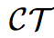
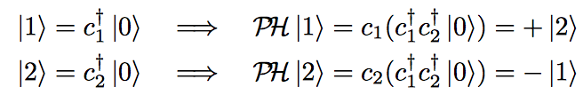
ν=1/2n
PH symmetry
(up to a layer switching)
ν=1-1/2n
PH symmetry is nonlocal
Filled LL <-> empty LL
PH is anti-unitary

Slide 27
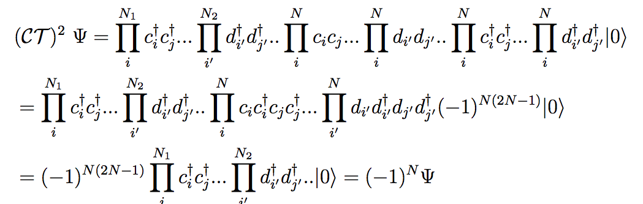
ν=1/2n
ν=1-1/2n
N is the total number of electrons in bilayer system
When N is odd, Kramers degeneracy!
PH symmetry is anti-unitary!

Slide 28



k
-e/2n
e/2n
-k
-e/2n
e/2n
Phase factor cannot be gauged away

Slide 29

Back scattering between layer (near 2k_f)
✔ PH odd!
for any PH even operator with respect to bilayer tunneling, such Back scattering does not contribute!
-> Lack of 2k_f singularity!
✔Higher order singularity is allowed, due to 4 fermion scattering process
ν=1/2n
K
-K
ν=1-1/2n

Slide 30
Competing order in bilayer system with ν=1/2n + ν= 1-1/2n ?
Inter-layer SC:
Higgs a⁺
Pairing angular momentum shift by 1 due to Berry phase (s -> p wave)
✔ a⁻ Maxwell theory= Goldstone mode of interlayer superfluid (111)
ν=1/2n
Layer coherent Composite liquid
K
-K
ν=1-1/2n
Coexist?
✔ Z_{4n} topological order!
✔ No explicit symmetry breaking, fully gapped state.

Slide 31
Summary
Partial filled Landau Level at arbitrary even filling fraction
Berry phase on the composite Fermi surface as a consequence of LL projection
After LL projection, the PH symmetry is Non-local and anti-unitary
Probe fractional Berry phase by 2k_f scattering
Exotic quantum critical point at bilayer
Z_{4n} TO emerge at quantum critical point
Fractional Berry phase liquid Beyond dipole picture?
Coupled wire construction: CFL+ ACFL stripes, PH invariant interaction

Slide 32
Thank you !
Reference:
Y You arxiv:1704.034643
Y You, E Fradkin to appear

Slide 33
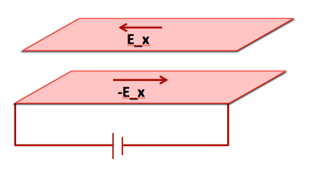
Experiment signature of ICCFL
Drag experiment
In addition:
Quantized Hall conductance in the counter channel A⁻
A⁺ remain gapless, due to Fermi surface

Slide 34




Essential to turn on coherence/tunneling between CF in each layer
K_x
K_y
FS splitting
PH odd scattering!
Does not contribute to PH even operator

Slide 35
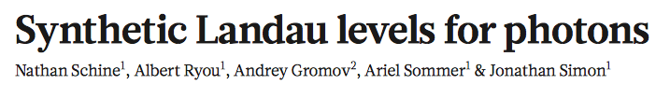
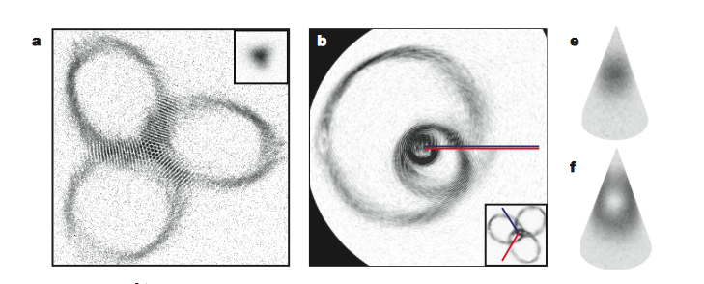

Slide 36
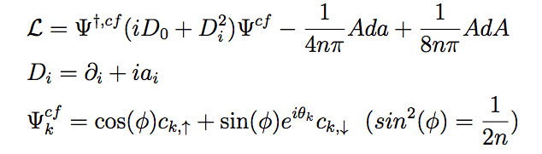

A fermi surface with π/n Berry phase?
✓ Only Involves Fermion near Fermi surface
✓ `Spin’ in the x-y plane = dipole orientation, Locked with momentum
✓ Choice is not unique

Slide 37
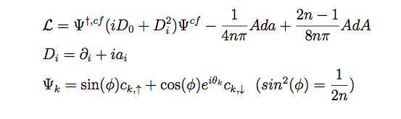
ν=1-1/2n filled LL (PH conjugate of ν=1/2n)
A Fermi surface with π(2-1/n) Berry phase?
The fractional Berry phase is a consequence of LL projection!

Slide 38
 | ICCFL from HLR | ICCFL from Son
Nematic structure and Half quantum vortex | No | Yes
Overdamped Goldstone mode | No | Yes
Enhanced intra-layer SC at criticality | No | Yes
Wen-Zee effect | No | Yes

Slide 39
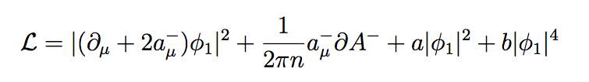
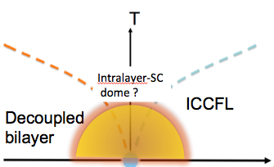
✔ Exciton carries gauge charge 2a⁻
✔ Exciton= 4n*2\pi vortices of interlayer superfluid
Exciton fluctuation enhance inter-layer SC
Interlayer-SC
Critical coherent boson enhance layer SC
--> Coexistence between interlayer SC + coherence

